Slide 2
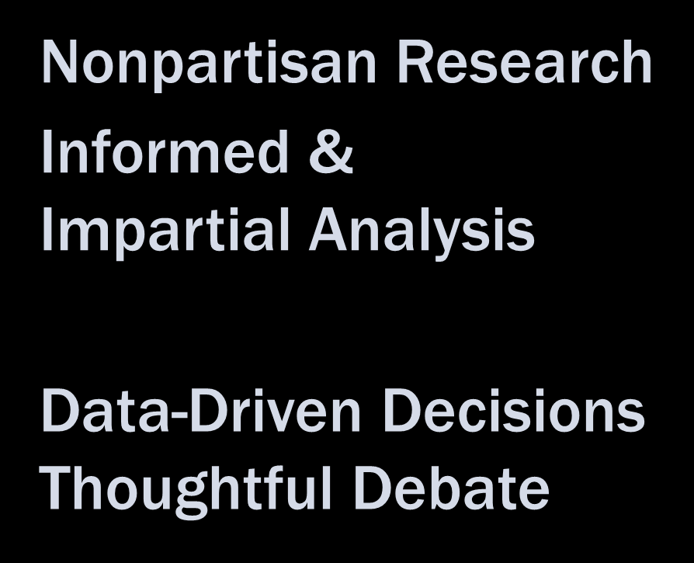

Slide 3
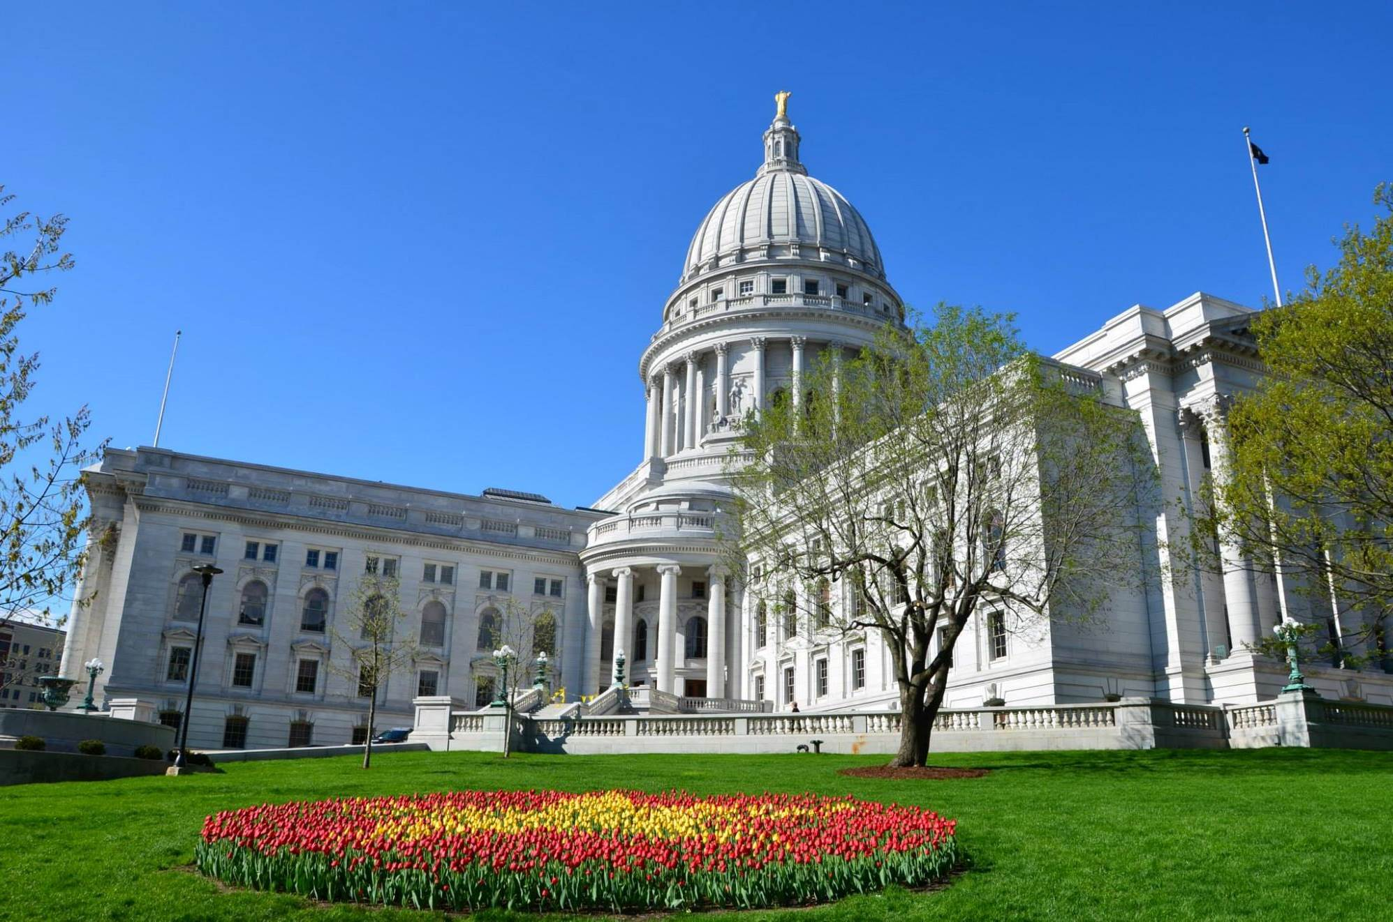
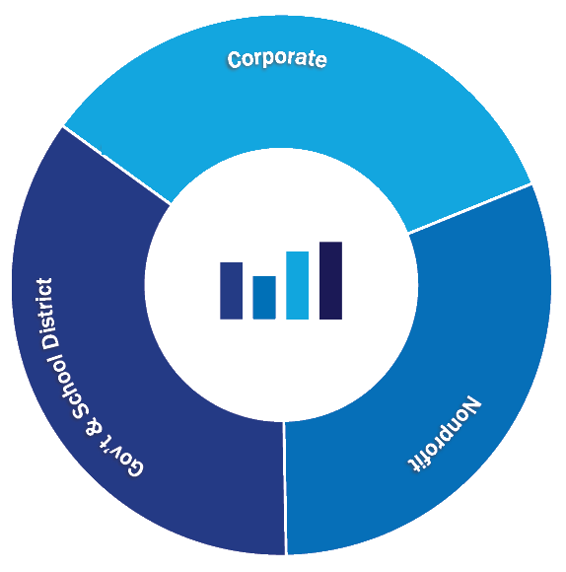
Nonprofit
Gov’t and School District
Corporate

Slide 4
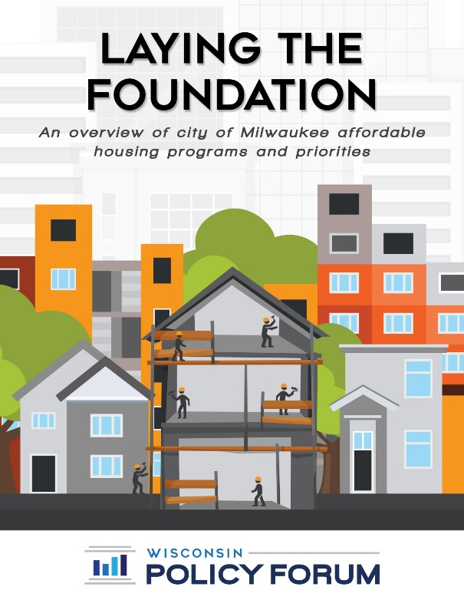
Research Reports

Slide 5
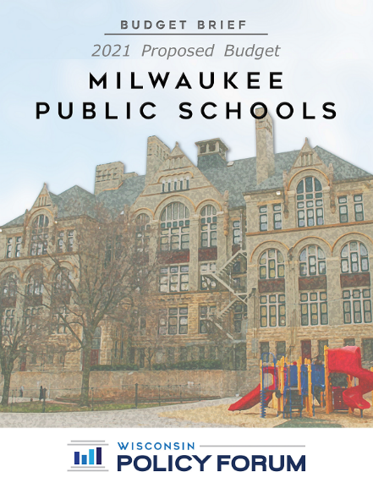
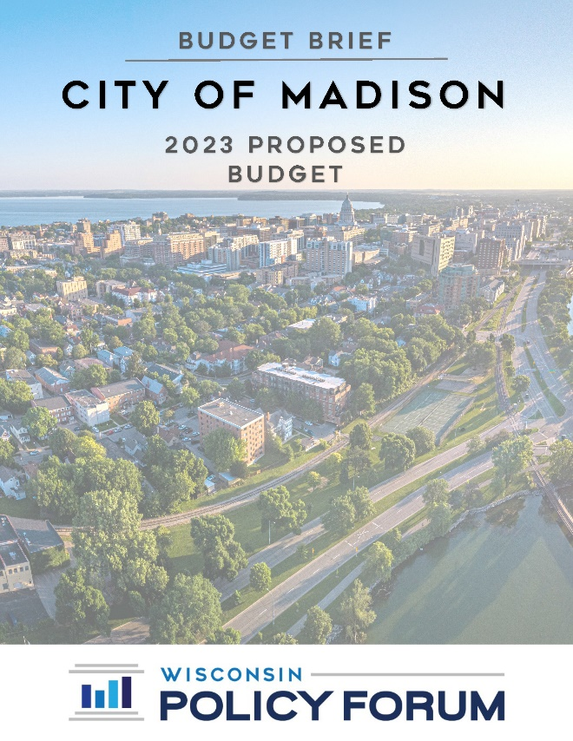
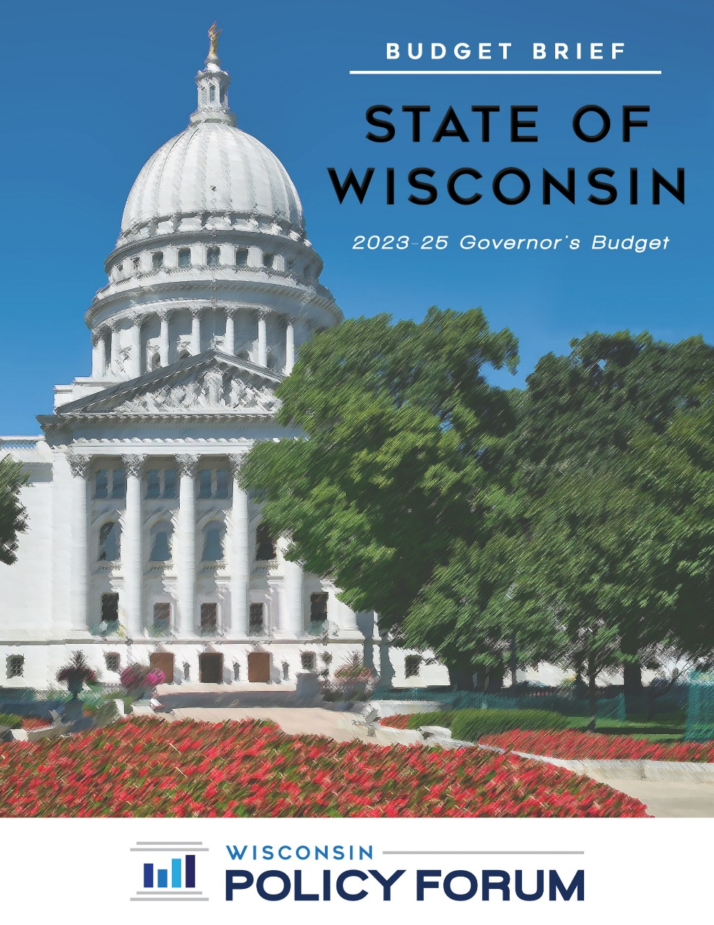
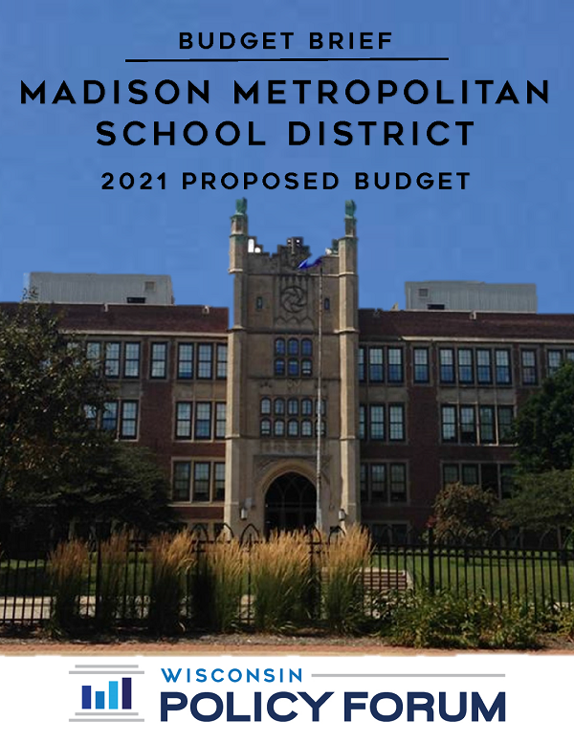
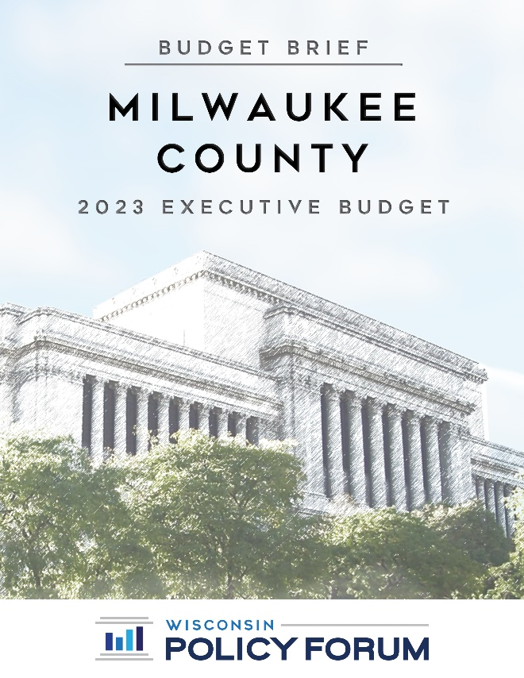
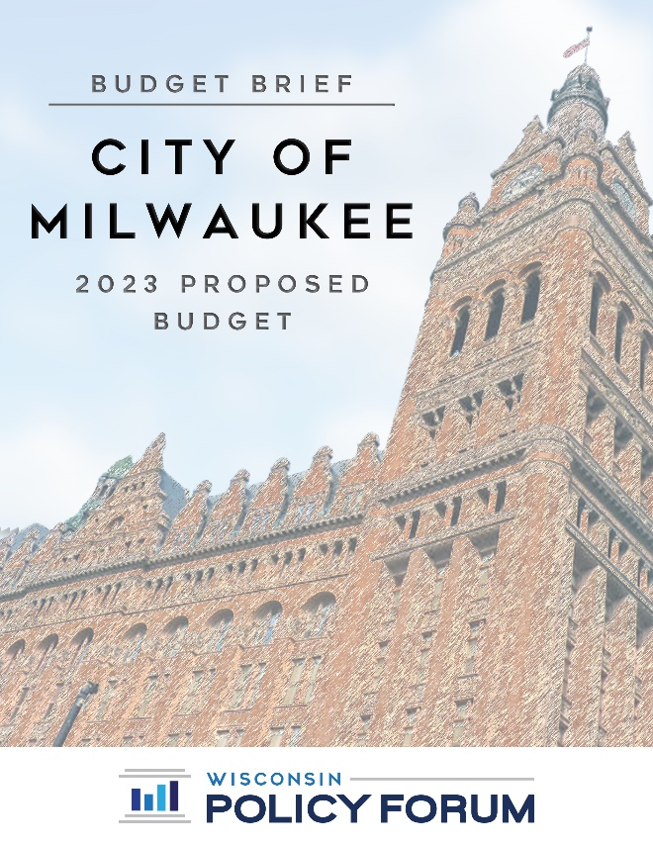
Budget Briefs

Slide 6
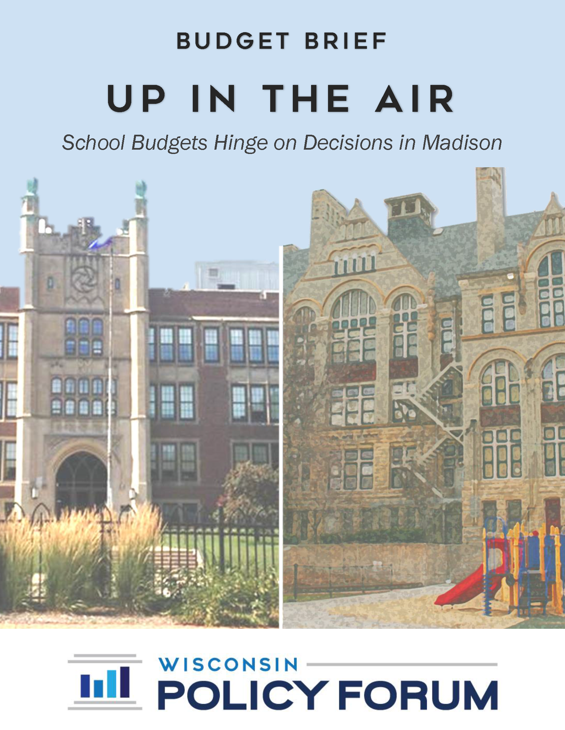

Slide 8
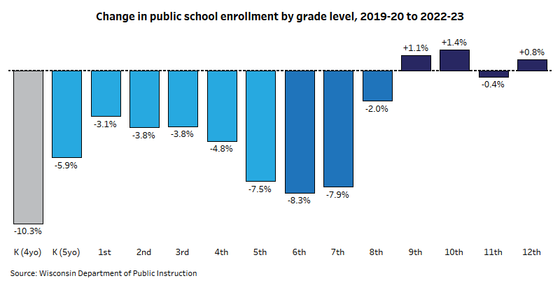

Slide 9
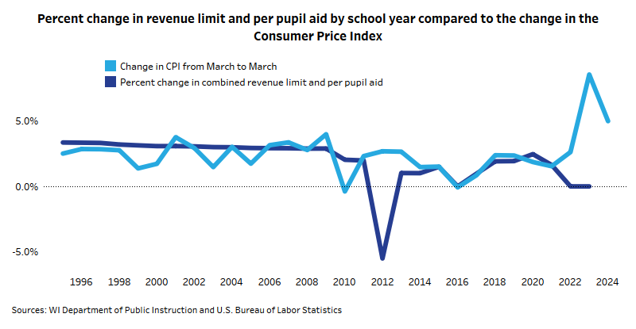

Slide 10
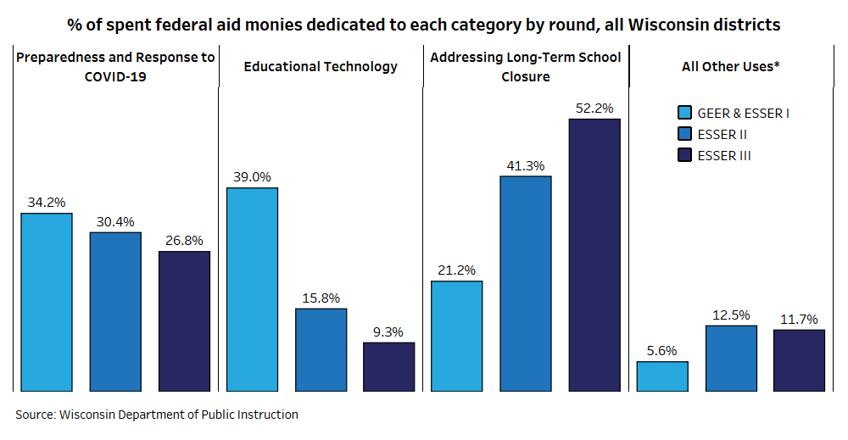

Slide 11
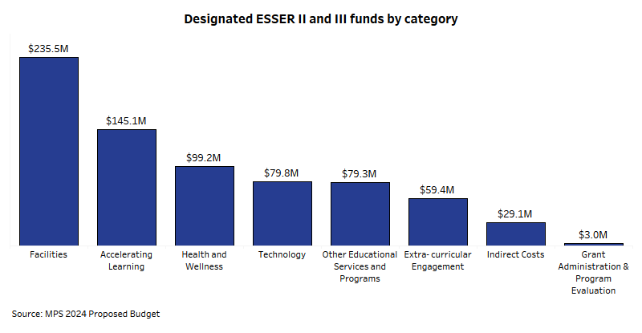

Slide 12
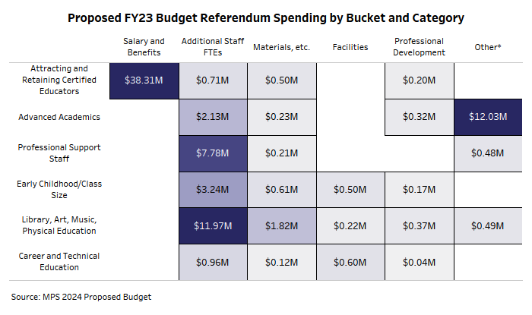

Slide 14
Fund | 2023 Adopted | 2024 Proposed | 2023 to 2024 % change
School operations | $1,046.5 | $1,036.1 | -1.0%
Categorical | $727.8 | $352.7 | -51.5%
Construction | $3.6 | $7.1 | 97.2%
Nutrition | $47.9 | $57.7 | 20.4%
Extension | $42.3 | $42.5 | 0.4%
Total | $1,868.1 | $1,496.0 | -19.9%
Source: MPS 2024 proposed budget

Slide 15
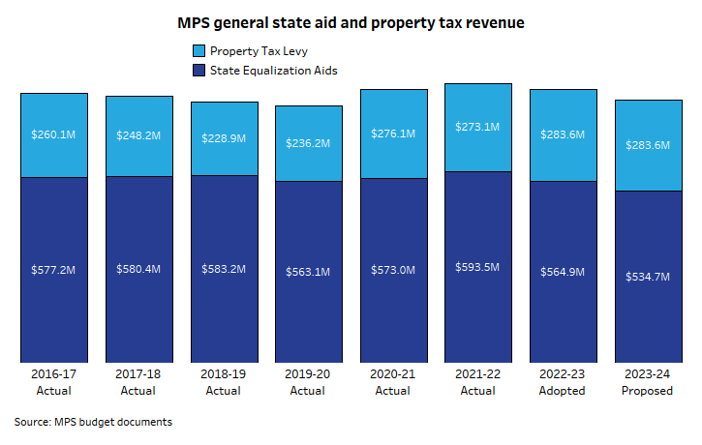

Slide 17
Expenditures | 2022 Actual | 2023 Adopted | 2024 Proposed | 2022 to 2024 % Change
Schools | $1,009.1 | $1,190.3 | $1,237.1 | 22.6%
Central Services | $274.4 | $654.7 | $268.5 | -2.2%
Other Accounts | $104.9 | $29.6 | $1.1 | -99.0%
Inter-department & Inter-fund | $-6.9 | $-6.5 | $-10.6 | 53.6%
Total | $1,381.6 | $1,868.2 | $1,496.1 | 8.3%
Source: MPS 2024 proposed budget

Slide 19
Expenditures | 2022 Actual | 2023 Adopted | 2024 Proposed | 2022 to 2024 % Change
Schools | $1,009.1 | $1,190.3 | $1,237.1 | 22.6%
Central Services | $274.4 | $654.7 | $268.5 | -2.2%
Other Accounts | $104.9 | $29.6 | $1.1 | -99.0%
Inter-department & Inter-fund | $-6.9 | $-6.5 | $-10.6 | 53.6%
Total | $1,381.6 | $1,868.2 | $1,496.1 | 8.3%
Source: MPS 2024 proposed budget

Slide 20
Central Services Expenditures
Shrink by $5.9 Million (2022-2024)

Slide 21
Expenditures | 2022 Actual | 2023 Adopted | 2024 Proposed | 2022 to 2024 % Change
Schools | $1,009.1 | $1,190.3 | $1,237.1 | 22.6%
Central Services | $274.4 | $654.7 | $268.5 | -2.2%
Other Accounts | $104.9 | $29.6 | $1.1 | -99.0%
Inter-department & Inter-fund | $-6.9 | $-6.5 | $-10.6 | 53.6%
Total | $1,381.6 | $1,868.2 | $1,496.1 | 8.3%
Source: MPS 2024 proposed budget

Slide 22
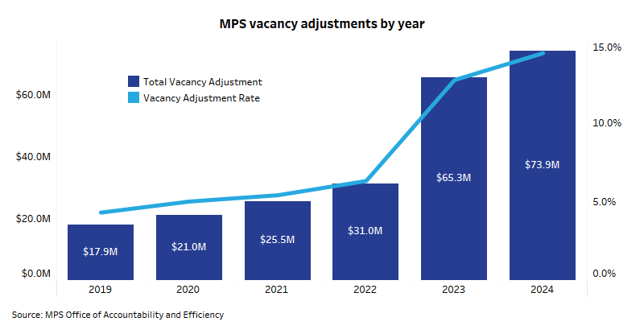

Slide 23
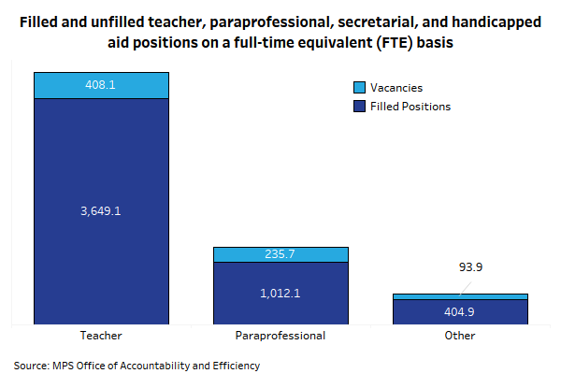

Slide 24
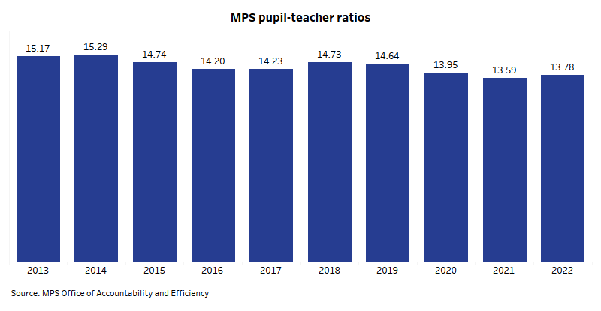

Slide 25
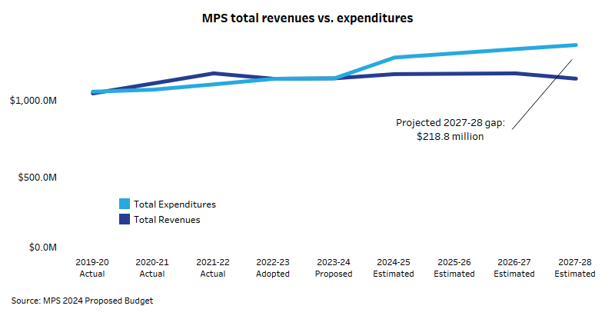

Slide 26
